Slide 1
Student Management System
Erdem demir 030118060
Tayyib Bayram 030118106

Slide 2
Log IN
1234

Slide 3
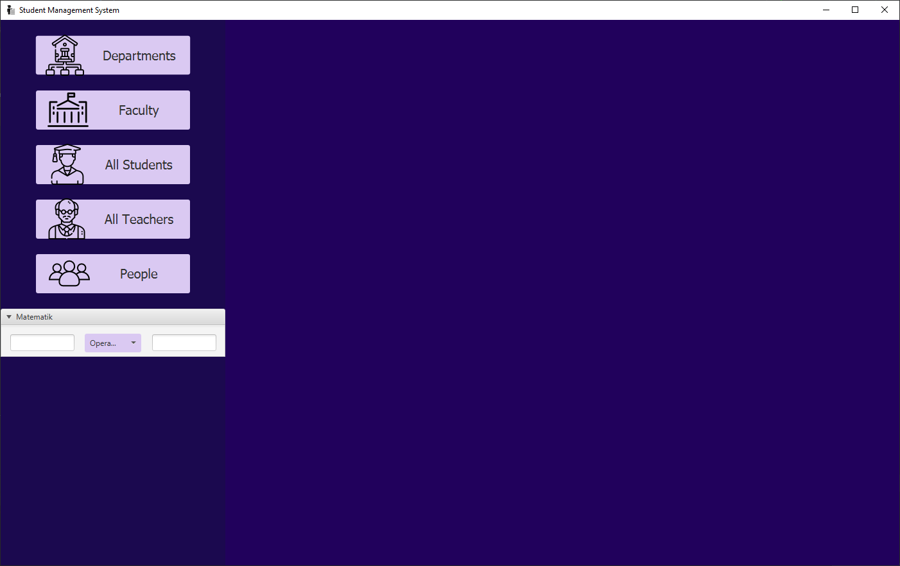
HOME

Slide 4
Departments

Slide 5
Departments

Slide 6
PEOPLE

Slide 7
MATH

Slide 8
Classes

Slide 9
Student

Slide 10
Teacher

Slide 11
Department

Slide 12
Faculty

Slide 13
Person

Slide 14
Database Class

Slide 15
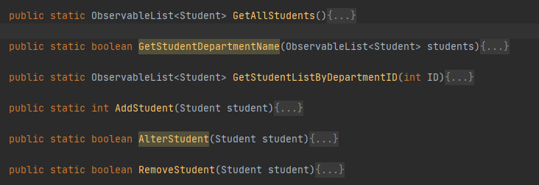
Student

Slide 16
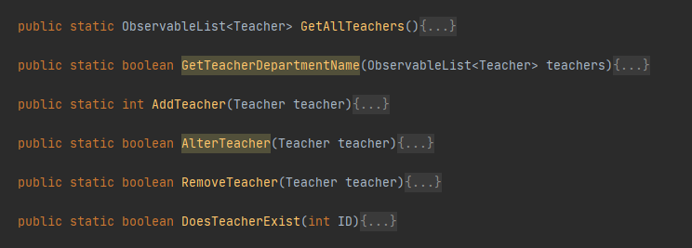
Teacher

Slide 17
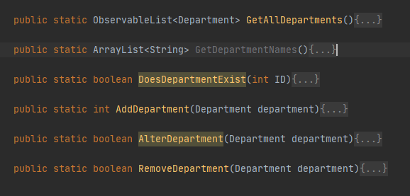
Department

Slide 18
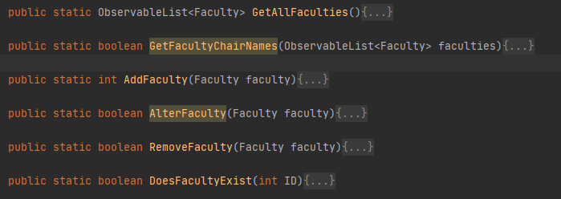
Faculty

Slide 19
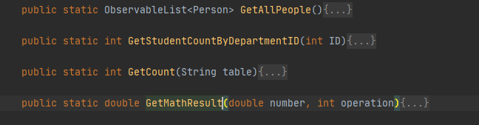
MISC

